Slide 1

Course Name: Hardware Security
Faculty Name: Prof Debdeep Mukhopadhyay
Department : Computer Science and Engineering
Topic
Lecture 08: Background on Cryptography, Cryptanalysis
and Advanced Encryption Standard (AES)

Slide 2

Concepts Covered:
Goals of Cryptography
Types of Cryptography
Block Ciphers
AES: Advanced Encryption Standard

Slide 3



Goals of Cryptography
Confidentiality
Dear Alice,
Bob
Alice
Eve
Integrity
Availability

Slide 4
Confidentiality
Information is exchanged over the un-trusted network.
Information, while exchange, should remain secret.
Confidentiality related to both the storage as well as transmission of information.

Slide 5
Integrity
Information is always changing.
But the change should be made by authorized users
modification: change made by unauthorized users.
Need techniques to ensure the integrity of data:
preventing the modification
detect any modification made

Slide 6
Availability
Confidentiality and Integrity should not hinder the availability of data.
Data must be available to authorized users.
Cryptographic mechanisms should have a small overhead.

Slide 7
Mechanisms
Cryptographic Algorithms are used to achieve the above goal.
They rely on a secret piece of information, called the key.
The algorithms are published.
Attackers objective is to obtain the key from the communication.

Slide 8
Cryptosystem
A cryptosystem is a five-tuple (P,C,K,E,D), where the following are satisfied:
P is a finite set of possible plaintexts
C is a finite set of possible ciphertexts
K, the keyspace, is a finite set of possible keys
∀K∈K
Encryption Rule : ∃e_{K}∈E
Decryption Rule : ∃d_{K}∈D Each e_{K}: P→C and d_{K}: C→P are functions
such that ∀x∈P, d_{K}(e_{K}(x)) = x.

Slide 9
Taxonomy of Crypto
Symmetric Key
Same key for encryption as for decryption
K_{a}=K_{b}
Asymmetric Key
Two keys, one for encryption (public), and one for decryption (private)
K_{a}≠K_{b}
K_{a} is often referred to as the public key
K_{b} is often referred to as the private key
Assumption: It is a hard problem to infer K_{b} from K_{a}

Slide 10
Block Cipher : A Symmetric Key Encryption
Key Length
Secret Key
Plaintext
Ciphertext
Block Cipher
(Encryption)
A block cipher encryption algorithm encrypts n bits of plaintext at a time
C = E_{k}(P)
Block Length

Slide 11
Block Cipher : Decryption
Key Length
Secret Key
Ciphertext
Plaintext
Block Cipher
(Decryption)
Block Length
A block cipher decryption algorithm recovers the plaintext from the ciphertext.
P = D_{k}(C)
Notes:
11

Slide 12
Structure of a Block Cipher
Plaintext Block
Secret Key
Key Whitening
Round 1
Round Key 1
Key Expansion
Round 2
Round Key 2
Round 3
Round Key 3
Ciphertext Block
Round n
Round Key n

Slide 13
Key and Block length
Generally 128, 192, or 256 bits
The key and block length can be independent of each other
The choice of length decides how effective the cipher is against brute force attacks.
80 bits is considered the minimum requirement.
Longer lengths however result in slower encryption times, thus more performance overheads.
Notes:
Construction of the cipher : How effectively the cipher can randomize the input. Or how effectively the cipher can hide information about the input.
13

Slide 14
An Encryption Round
Consists of three operations
Addition of Round Key
Confusion : Hides the relation between the ciphertext and the key.
Diffusion : Hides the relation between the ciphertext and the plaintext.
Number of rounds is determined by the cipher’s resistance to known attacks.
Round Input
Addition of Round Key
Confusion Layer
Diffusion Layer
Round Output

Slide 15
Cryptographic Attacks
Cryptanalytic Attacks:
Applies mathematical techniques to obtain the key better than a brute force search (try all possibilities)
All attacks are distinguishers:
all (good) ciphers transforms the plaintext distribution to “appear” as random.
the goal of an attack is to find properties in the cipher which does not exist in random distribution.
Attacker guesses a portion of the key and checks for the property.
Any attack better than a brute force search qualifies as an attack.
May not be practical but exposes design flaw.

Slide 16
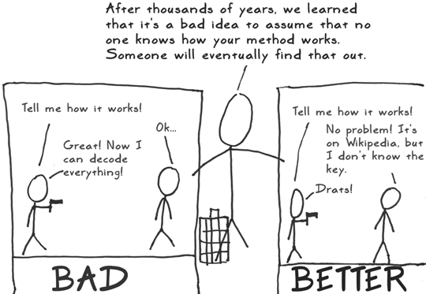
Cryptanalysis and the Kerckhoff’s Principle
The cryptosystem is known to the adversary.
But the key is not known to the attacker.
The secrecy of the cryptosystem lies in the key.
Cryptanalysis is the art of obtaining the key.

Slide 17
A Basic Cipher and the notion of Differential
c=m ⊕ k, where each variable is of b bits.
If the key is chosen at random and used only once, then cryptanalyst gains no information about m from c.
What happens if the same key is used twice.
c₀ ⊕ c₁=(m₀ ⊕ k) ⊕(m₁ ⊕ k)=m₀ ⊕m₁.
Provides a notion of ‘difference’ which does not depend on the key!

Slide 18
An Exercise on Cryptanalysis
x | 0 1 2 3 4 5 6 7 8 9 a b c d e f
S[x] | 6 4 c 5 0 7 2 e 1 f 3 d 8 a 9 b
k₀
k₁
⊕
⊕
m
u
S
v
c
Study the ‘differential’ behavior.
Consider two encryptions with a pair of plaintexts, m₀ and m₁.
The attacker knows the difference of the internal values, u₀ ⊕ u₁.

Slide 19
Attack on the Cipher
u₀ ⊕ u₁=S⁻¹[v₀] ⊕ S⁻¹[v₀]
Attacker guesses k₁, and estimates v₀ and v₁, and evaluates the above.
If more than one values of k₁ satisfy, try with other messages.
Observations:
Differences between internal variables are exposed.
Recover key information by guessing parts of the key and testing whether a differential holds.

Slide 20
The Differential Attack
k0
k1
k0
k1
↓
↓
↓
↓
5→⊕→u₁→ →v₁→⊕→6
a→⊕→u₀→ →v₀→⊕→9
S
S
S
u’=u₀ ⊕ u₁ = a ⊕ 5 = f.
Consider the inverse R[.] from S[.]:
For each value t of k₁, check: R[t ⊕ 9] ⊕R[t ⊕6]=f => k₁ϵ{7,8}
x | 0 1 2 3 4 5 6 7 8 9 a b c d e f
R[x] | 4 8 6 a 1 3 0 5 c e d f 2 b 7 9
t | 0 1 2 3 4 5 6 7 8 9 a b c d e f
u' | e b e e d 8 d f f d 8 d e e b e

Slide 21
The Differential Attack (Contd.)
k0
k1
k0
k1
↓
↓
↓
↓
9→⊕→u₀→ →v₀→⊕→7
S
8→⊕→u₁→ →v₁→⊕→0
S
u₀ ⊕ u₁ = 9 ⊕ 8 = 1.
For each value t of k₁, check:
R[t ⊕ 7] ⊕R[t ⊕0]=1 => k₁ϵ{0,7}
Thus, k₁=7, and k₀=d.
t | 0 1 2 3 4 5 6 7 8 9 a b c d e f
u’ | 1 8 5 b b 5 8 1 5 9 2 b b 2 9 5

Slide 22
Advanced Encryption Standard (AES)
NIST’s standard for block cipher since October 2000.
Each round has
Randomness Layer: Round key addition
Confusion Layer : Byte Substitution
Diffusion Layer : Shift row and Mix column
(the last round does not have mix column step)
 | Key Length | No. of rounds
AES-128 | 16 bytes | 10
AES-192 | 24bytes | 12
AES-256 | 32bytes | 14

Slide 23
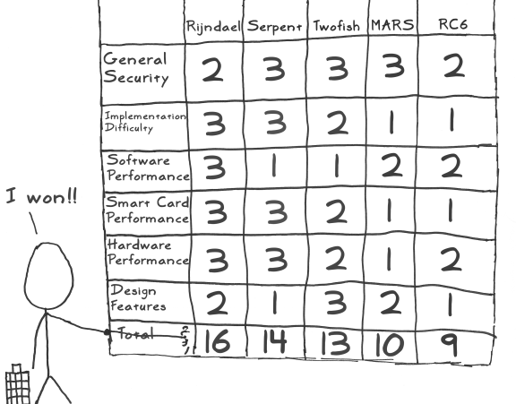

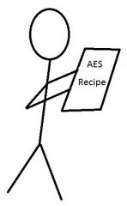
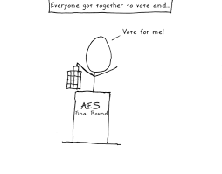
What is AES?
Ref: http://www.moserware.com/2009/09/stick-figure-guide-to-advanced.html

Slide 24
The AES State Representation
16 bytes Plaintext
a
b
c
d
e
f
g
h
i
j
k
l
m
n
o
p
a
e
i
m
AES
A
E
I
M
b
f
j
n
B
F
J
N
c
g
k
o
C
G
K
O
d
h
l
p
D
H
L
P
16 bytes Cipher text
16 bytes arranged in a 4x4 matrix of bytes

Slide 25
AES-128 Encryption
Plaintext
Block
Secret Key
XOR key
Byte Substitution
Loop 10 times
Shift Rows
Mix Columns
(except for the last round)
RK1
RK2
Ciphertext
Block
RK3
Add Round Key
RK10
Key Expansion

Slide 26
AES-128 Decryption
Ciphertext Block
Secret Key
XOR RK10
Inverse Byte Substitution
Loop 10 times
Inverse Shift Rows
Add Round Key
RK9
Plaintext
Block
RK8
Inverse Mix Columns
(except for the last round)
RK1
key
Key Expansion

Slide 27
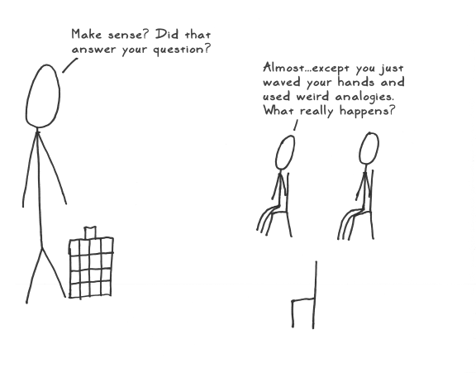
We shall discuss in details in next class!

Slide 28
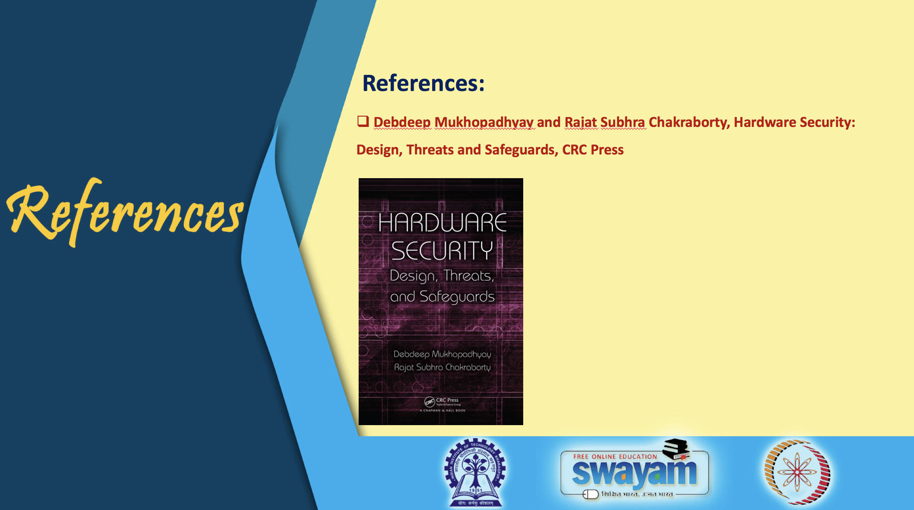

Slide 29
Conclusion:
Cryptographic Implementations should be lightweight
Types of Ciphers
Block Cipher constructions constitute of Non-linear and Linear components
Encryption algorithms are published, the secret is in the key.
Idea of Differential Attacks were discussed.
AES is composed of different sub-operations: AddRoundKey, Byte Substitution, ShiftRows, MixColumns.

Slide 30


